Slide 1

BHP Mining Operations SQL Project
Michael Le

Slide 2
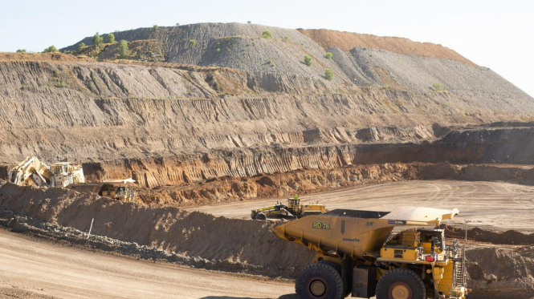
Requirements
Install and Download SQL Server Express (2022,or 2025 (much preferred)) from Microsoft
Files and sources from my repository:
Main-Stuff/DA Bootcamp 2026 Emergi Mentors/Week 2 SQL Mastery/Module 4 Advanced SQL and Enterprise Analytics/BHD_Mining_Operations_Report_Automation at main · Mikele02171/Main-Stuff

Slide 3
Content
Create Database for BHP Mining Operations
DDL: Creating Tables for Mining Sites, Daily Production, Safety Incidents, Error Log
DML: Insert Values into Mining Sites, Daily Production, Safety Incidents
DQL: Validation Checks
Stored Procedure/DQL: Create Procedure and Query for GetSiteProduction
Stored Procedure/DQL: Create Procedure and Query for GetProductionByDateRange
Stored Procedure/DQL: Create Procedure and Query for GetProductionFlexible
Stored Procedure/DQL: Create Procedure and Query for GetSiteSummary
Stored Procedure/DQL: Create Procedure and Query for GetSafeProductionReport
Stored Procedure/DQL: Create Procedure and Query for DailyOperationsReport
Stored Function/DQL: Create Function and Query for dbo.CalculateEfficiency
Stored Function/DQL: Create Function and Query for dbo.GetHighDowntimeSites
Stored Procedure/DQL: Create Procedure and Query for GetIncidentsBySeverity
Stored Procedure/DQL: Create Procedure and Query for GetProductionSummary
Stored Function/DQL: Create Function and Query for dbo.CalculateOreToWasteRatio
Stored Function/DQL: Create Function and Query for dbo.GetTopPerformingSites
Stored Procedure/DQL: Create Procedure and Query for UpdateIncidentStatus

Slide 4
Create Database for BHD Mining Operations
-- Drop database if exists (fresh start)
IF EXISTS (SELECT name FROM sys.databases WHERE name = 'BHD_Mining_Operations')
BEGIN
PRINT '⚠️ Dropping existing database...';
ALTER DATABASE BHP_Mining_Operations SET SINGLE_USER WITH ROLLBACK IMMEDIATE;
DROP DATABASE BHP_Mining_Operations;
END
GO
CREATE DATABASE BHP_Mining_Operations;
GO
USE BHP_Mining_Operations;
GO
PRINT '✅ Database Created: BHP_Mining_Operations';
PRINT '';
GO

Slide 5
DDL: Creating Tables for Mining Sites, Daily Production, Safety Incidents, Error Log Part 1
-- Mining Sites Table
CREATE TABLE mining_sites (
site_id INT PRIMARY KEY,
site_name NVARCHAR(100) NOT NULL,
site_location NVARCHAR(100) NOT NULL,
state NVARCHAR(10) NOT NULL,
commodity NVARCHAR(100) NOT NULL,
operational BIT DEFAULT 1, -- Added from playbook
capacity_tonnes_per_day DECIMAL(12,2) NULL -- Added for context
);
-- Daily Production Table
CREATE TABLE daily_production (
production_id INT PRIMARY KEY IDENTITY(1,1),
production_date DATE NOT NULL,
site_id INT NOT NULL,
shift NVARCHAR(20) NOT NULL CHECK (shift IN ('Day', 'Night')),
ore_tonnes DECIMAL(12,2) NOT NULL CHECK (ore_tonnes >= 0),
waste_tonnes DECIMAL(12,2) NOT NULL CHECK (waste_tonnes >= 0),
equipment_hours DECIMAL(8,2) NOT NULL CHECK (equipment_hours >= 0),
downtime_hours DECIMAL(6,2) NOT NULL CHECK (downtime_hours >= 0),
efficiency_percent AS (CASE
WHEN equipment_hours > 0
THEN ROUND(((equipment_hours - downtime_hours) / equipment_hours) * 100, 2)
ELSE 0
END) PERSISTED, -- Calculated column from playbook
CONSTRAINT FK_Production_Site FOREIGN KEY (site_id) REFERENCES mining_sites(site_id)
);

Slide 6
DDL: Creating Tables for Mining Sites, Daily Production, Safety Incidents, Error Log Part 2
-- Safety Incidents Table
CREATE TABLE safety_incidents (
incident_id INT PRIMARY KEY IDENTITY(1,1),
incident_date DATE NOT NULL,
site_id INT NOT NULL,
severity NVARCHAR(20) NOT NULL CHECK (severity IN ('Minor', 'Moderate', 'Severe')),
incident_type NVARCHAR(100) NOT NULL,
description NVARCHAR(500) NULL, -- Added for detail
resolved BIT DEFAULT 0,
resolved_date DATE NULL,
CONSTRAINT FK_Incidents_Site FOREIGN KEY (site_id) REFERENCES mining_sites(site_id)
);
-- Error Log Table (Production Best Practice from playbook)
CREATE TABLE error_log (
error_id INT PRIMARY KEY IDENTITY(1,1),
error_message NVARCHAR(4000),
error_procedure NVARCHAR(128),
error_line INT,
error_severity INT,
error_state INT,
logged_date DATETIME DEFAULT GETDATE(),
logged_by NVARCHAR(128) DEFAULT SYSTEM_USER
);

Slide 7
DML: Insert Values into Mining Sites, Daily Production Part 1
-- BHD's fictitious Australian mining sites (inspired by real locations)
INSERT INTO mining_sites (site_id, site_name, site_location, state, commodity, operational, capacity_tonnes_per_day) VALUES
(1, 'Red Rock Mine', 'Roxby Downs, SA', 'SA', 'Copper, Uranium, Gold, Silver', 1, 250000),
(2, 'Mt Pioneer Coal', 'Muswellbrook, NSW', 'NSW', 'Thermal Coal', 1, 180000),
(3, 'Goldfields Operations', 'Kalgoorlie, WA', 'WA', 'Nickel', 1, 150000),
(4, 'Northern Iron', 'Pilbara, WA', 'WA', 'Iron Ore', 1, 300000),
(5, 'Western Ridge', 'Pilbara, WA', 'WA', 'Iron Ore', 1, 280000);
PRINT '✅ 5 BHD fictitious mining sites inserted';
-- Daily production (last 14 days for each site × 2 shifts)
DECLARE @StartDate DATE = DATEADD(DAY, -14, CAST(GETDATE() AS DATE));
DECLARE @CurrentDate DATE = @StartDate;
DECLARE @SiteID INT;
DECLARE @ProductionCount INT = 0;

Slide 8
DML: Insert Values into Mining Sites, Daily Production Part 2
WHILE @CurrentDate <= CAST(GETDATE() AS DATE)
BEGIN
SET @SiteID = 1;
WHILE @SiteID <= 5
BEGIN
-- Day shift (higher production)
INSERT INTO daily_production (production_date, site_id, shift, ore_tonnes, waste_tonnes, equipment_hours, downtime_hours)
VALUES (
@CurrentDate,
@SiteID,
'Day',
ROUND(8000 + (RAND() * 2000), 2),
ROUND(12000 + (RAND() * 3000), 2),
ROUND(20 + (RAND() * 4), 2),
ROUND(RAND() * 2, 2)
);

Slide 9
DML: Insert Values into Mining Sites, Daily Production Part 3
-- Night shift (slightly lower production)
INSERT INTO daily_production (production_date, site_id, shift, ore_tonnes, waste_tonnes, equipment_hours, downtime_hours)
VALUES (
@CurrentDate,
@SiteID,
'Night',
ROUND(7500 + (RAND() * 2000), 2),
ROUND(11000 + (RAND() * 3000), 2),
ROUND(20 + (RAND() * 4), 2),
ROUND(RAND() * 2, 2)
);
SET @SiteID = @SiteID + 1;
SET @ProductionCount = @ProductionCount + 2;
END
SET @CurrentDate = DATEADD(DAY, 1, @CurrentDate);
END
PRINT '✅ ' + CAST(@ProductionCount AS NVARCHAR(10)) + ' production records inserted (15 days × 5 sites × 2 shifts)';

Slide 10
DML: Insert Values into Safety Incidents
-- Safety incidents (realistic incidents over last 14 days)
INSERT INTO safety_incidents (incident_date, site_id, severity, incident_type, description, resolved, resolved_date) VALUES
(DATEADD(DAY, -13, GETDATE()), 1, 'Minor', 'Slip and fall', 'Employee slipped on wet floor near processing area', 1, DATEADD(DAY, -12, GETDATE())),
(DATEADD(DAY, -12, GETDATE()), 2, 'Minor', 'Equipment malfunction', 'Conveyor belt stopped unexpectedly', 1, DATEADD(DAY, -11, GETDATE())),
(DATEADD(DAY, -10, GETDATE()), 3, 'Moderate', 'Near miss - vehicle collision', 'Haul truck nearly collided with light vehicle', 1, DATEADD(DAY, -8, GETDATE())),
(DATEADD(DAY, -9, GETDATE()), 4, 'Minor', 'First aid required', 'Minor cut requiring first aid', 1, DATEADD(DAY, -9, GETDATE())),
(DATEADD(DAY, -7, GETDATE()), 2, 'Moderate', 'Equipment damage', 'Excavator hydraulic line rupture', 0, NULL),
(DATEADD(DAY, -5, GETDATE()), 5, 'Minor', 'PPE violation', 'Worker not wearing hard hat in designated area', 1, DATEADD(DAY, -4, GETDATE())),
(DATEADD(DAY, -3, GETDATE()), 1, 'Severe', 'Medical treatment injury', 'Operator injured, medical treatment required', 0, NULL),
(DATEADD(DAY, -2, GETDATE()), 3, 'Minor', 'Spill incident', 'Small hydraulic oil spill, contained immediately', 1, DATEADD(DAY, -1, GETDATE())),
(DATEADD(DAY, -1, GETDATE()), 4, 'Moderate', 'Fire alarm activation', 'False alarm from dust accumulation', 1, DATEADD(DAY, -1, GETDATE())),
(GETDATE(), 2, 'Severe', 'Equipment rollover', 'Light vehicle rollover, driver injured', 0, NULL);
PRINT '✅ 10 safety incidents inserted (with realistic details)';
PRINT '';
GO

Slide 11

DQL: Validation Checks
PRINT '=== Data Validation ===';
PRINT '';
SELECT
'mining_sites' AS TableName,
COUNT(*) AS Row_Count, --RowCount is a keyword, use Row_Count
'Operational sites' AS Description
FROM mining_sites
UNION ALL
SELECT
'daily_production',
COUNT(*),
CAST(COUNT(DISTINCT production_date) AS NVARCHAR(10)) + ' days of data'
FROM daily_production
UNION ALL
SELECT
'safety_incidents',
COUNT(*),
CAST(SUM(CASE WHEN resolved = 0 THEN 1 ELSE 0 END) AS NVARCHAR(10)) + ' unresolved'
FROM safety_incidents;
PRINT '';
GO

Slide 12
Stored Procedure/DQL: Create Procedure and Query for GetSiteProduction Part 1
-- Drop if exists
IF OBJECT_ID('GetSiteProduction', 'P') IS NOT NULL
DROP PROCEDURE GetSiteProduction;
GO
PRINT 'Creating Procedure: GetSiteProduction';
PRINT '';
GO
CREATE PROCEDURE GetSiteProduction
@SiteID INT
AS

Slide 13
Stored Procedure/DQL: Create Procedure and Query for GetSiteProduction Part 2
BEGIN
/*
Purpose: Get all production data for a specific mining site
Parameters: @SiteID (1=Red Rock Mine, 2=Mt Pioneer, etc.)
Returns: Production records with site details
Example: EXEC GetSiteProduction @SiteID = 1;
*/
SELECT
ms.site_name,
ms.site_location,
ms.state,
dp.production_date,
dp.shift,
dp.ore_tonnes,
dp.waste_tonnes,
dp.equipment_hours,
dp.downtime_hours,
dp.efficiency_percent
FROM daily_production dp
JOIN mining_sites ms ON dp.site_id = ms.site_id
WHERE dp.site_id = @SiteID
ORDER BY dp.production_date DESC, dp.shift;
END

Slide 14

Stored Procedure/DQL: Create Procedure and Query for GetSiteProduction Part 3
PRINT '✅ Procedure created: GetSiteProduction';
PRINT '';
PRINT 'Testing the procedure...';
PRINT '';
PRINT '--- Test 1: Red Rock Mine (Site 1) ---';
EXEC GetSiteProduction @SiteID = 1;
PRINT '';
PRINT '--- Test 2: Northern Iron (Site 4) ---';
EXEC GetSiteProduction @SiteID = 4;

Slide 15
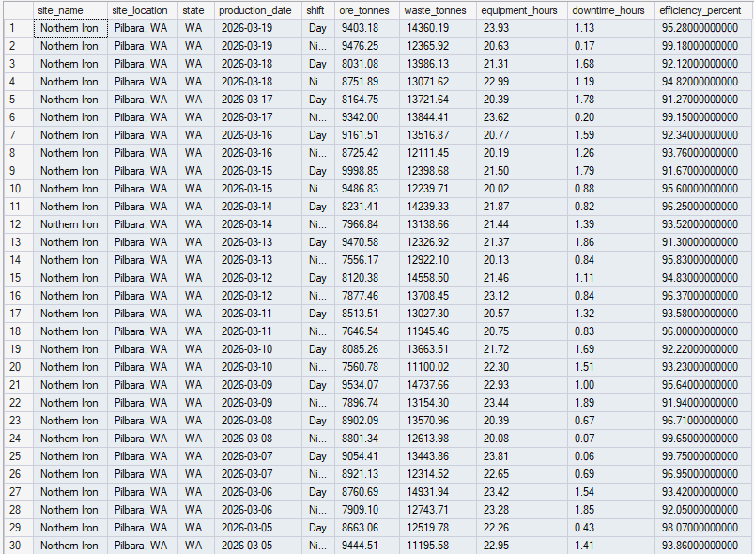
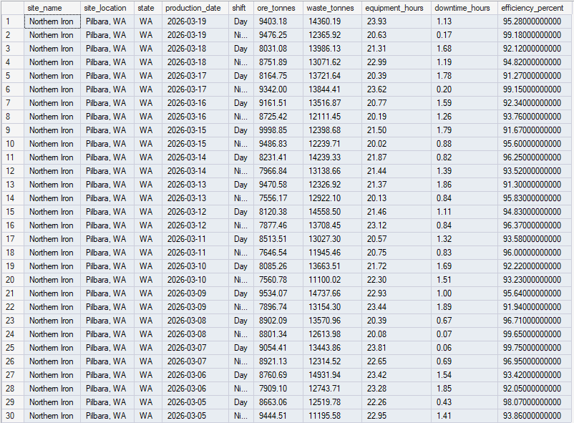
Stored Procedure/DQL: Create Procedure and Query for GetSiteProduction Results

Slide 16
Stored Procedure/DQL: Create Procedure and Query for GetProductionByDateRange Part 1
IF OBJECT_ID('GetProductionByDateRange', 'P') IS NOT NULL
DROP PROCEDURE GetProductionByDateRange;
GO
CREATE PROCEDURE GetProductionByDateRange
@StartDate DATE,
@EndDate DATE,
@SiteID INT
AS

Slide 17
Stored Procedure/DQL: Create Procedure and Query for GetProductionByDateRange Part 2
BEGIN
/*
Purpose: Get production data for a date range and specific site
Parameters:
@StartDate - Beginning of date range
@EndDate - End of date range
@SiteID - Which mining site
Returns: Filtered production records
Example: EXEC GetProductionByDateRange
@StartDate = '2024-12-01',
@EndDate = '2024-12-07',
@SiteID = 1;
*/
SELECT
ms.site_name,
dp.production_date,
dp.shift,
dp.ore_tonnes,
dp.waste_tonnes,
dp.downtime_hours,
dp.efficiency_percent
FROM daily_production dp
JOIN mining_sites ms ON dp.site_id = ms.site_id
WHERE dp.production_date BETWEEN @StartDate AND @EndDate
AND dp.site_id = @SiteID
ORDER BY dp.production_date, dp.shift;
END
GO

Slide 18
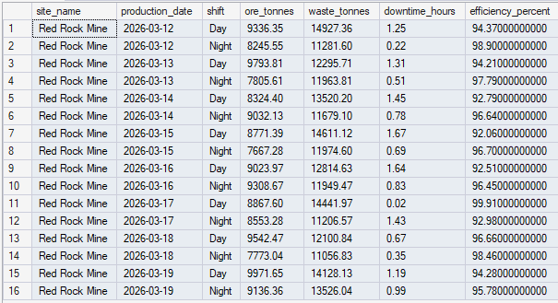
Stored Procedure/DQL: Create Procedure and Query for GetProductionByDateRange Part 3
PRINT '✅ Procedure created: GetProductionByDateRange';
PRINT 'Testing with 3 parameters...';
DECLARE @TestStart DATE = DATEADD(DAY, -7, GETDATE());
DECLARE @TestEnd DATE = GETDATE();
PRINT '--- Last 7 days for Red Rock Mine ---';
EXEC GetProductionByDateRange
@StartDate = @TestStart,
@EndDate = @TestEnd,
@SiteID = 1;
PRINT '';
GO

Slide 19
Stored Procedure/DQL: Create Procedure and Query for GetProductionFlexible Part 1
IF OBJECT_ID('GetProductionFlexible', 'P') IS NOT NULL
DROP PROCEDURE GetProductionFlexible;
GO
CREATE PROCEDURE GetProductionFlexible
@StartDate DATE = NULL, -- Default to NULL
@EndDate DATE = NULL, -- Optional
@SiteID INT = NULL -- Optional
AS
BEGIN
/*
Purpose: Flexible production query with optional filters
Parameters: All optional - defaults to last 7 days, all sites
Call Options:
EXEC GetProductionFlexible; -- Last 7 days, all sites
EXEC GetProductionFlexible @SiteID = 1; -- Last 7 days, Red Rock Mine only
EXEC GetProductionFlexible @StartDate = '2024-12-01', @EndDate = '2024-12-07';
*/

Slide 20
Stored Procedure/DQL: Create Procedure and Query for GetProductionFlexible Part 2
-- Set defaults if not provided
IF @StartDate IS NULL SET @StartDate = DATEADD(DAY, -7, GETDATE());
IF @EndDate IS NULL SET @EndDate = CAST(GETDATE() AS DATE);
SELECT
ms.site_name,
dp.production_date,
dp.shift,
SUM(dp.ore_tonnes) AS total_ore,
SUM(dp.waste_tonnes) AS total_waste,
AVG(dp.efficiency_percent) AS avg_efficiency
FROM daily_production dp
JOIN mining_sites ms ON dp.site_id = ms.site_id
WHERE dp.production_date BETWEEN @StartDate AND @EndDate
AND (@SiteID IS NULL OR dp.site_id = @SiteID) -- Optional filter pattern!
GROUP BY ms.site_name, dp.production_date, dp.shift
ORDER BY ms.site_name, dp.production_date, dp.shift;
END
GO

Slide 21
Stored Procedure/DQL: Create Procedure and Query for GetProductionFlexible Part 3
PRINT 'KEY PATTERN: (@SiteID IS NULL OR site_id = @SiteID)';
PRINT ' • If @SiteID IS NULL → Condition TRUE for all rows (no filter)';
PRINT ' • If @SiteID = 1 → Only rows where site_id = 1';
PRINT ' • This is a STANDARD pattern for optional filters!';
PRINT '';
PRINT 'Testing different call variations...';
PRINT '';
PRINT '--- Call 1: No parameters (uses defaults: last 7 days, all sites) ---';
EXEC GetProductionFlexible;
PRINT '';
PRINT '--- Call 2: Filter by site only ---';
EXEC GetProductionFlexible @SiteID = 1;
PRINT '';
PRINT '--- Call 3: Custom date range, all sites ---';
DECLARE @StartDate datetime = DATEADD(DAY, -3, GETDATE());
DECLARE @EndDate datetime = GETDATE();
EXEC GetProductionFlexible
@StartDate = @StartDate,
@EndDate = @EndDate;
--@StartDate = (SELECT DATEADD(DAY, -3, GETDATE())),
--@EndDate = (SELECT GETDATE());
PRINT '';
GO

Slide 22
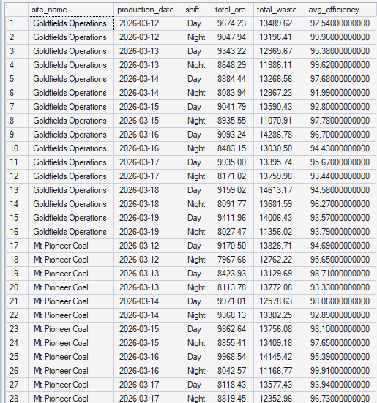
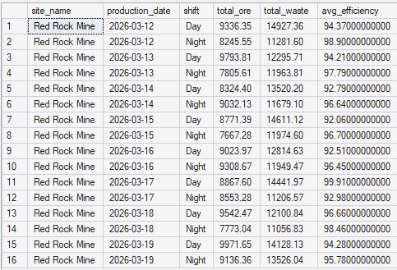
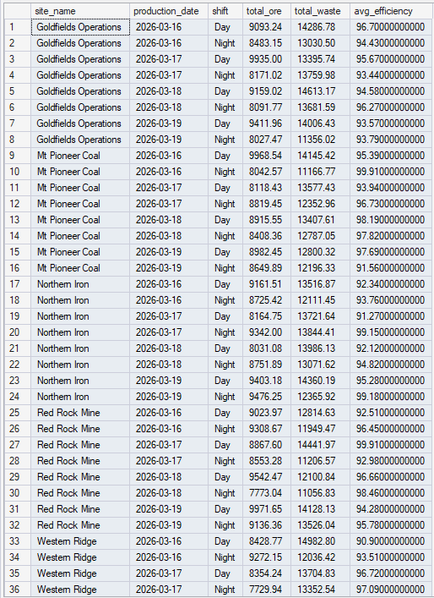
Stored Procedure/DQL: Create Procedure and Query for GetProductionFlexible Results
Figure 2. Filter by State,
for example Red Rock Mine
Figure 1. No parameters
Figure 3. Custom date range, all sites

Slide 23
Stored Procedure/DQL: Create Procedure and Query for GetSiteSummary Part 1
IF OBJECT_ID('GetSiteSummary', 'P') IS NOT NULL
DROP PROCEDURE GetSiteSummary;
GO
CREATE PROCEDURE GetSiteSummary
@SiteID INT,
@TotalOre DECIMAL(12,2) OUTPUT, -- OUTPUT parameter
@TotalIncidents INT OUTPUT, -- OUTPUT parameter
@DowntimePercent DECIMAL(5,2) OUTPUT -- OUTPUT parameter
AS
BEGIN
/*
Purpose: Calculate summary metrics for a site
Parameters:
@SiteID - Input
@TotalOre - OUTPUT (returns total ore produced)
@TotalIncidents - OUTPUT (returns unresolved incident count)
@DowntimePercent - OUTPUT (returns downtime percentage)
Example:
DECLARE @Ore DECIMAL(12,2), @Incidents INT, @Downtime DECIMAL(5,2);
EXEC GetSiteSummary @SiteID = 1,
@TotalOre = @Ore OUTPUT,
@TotalIncidents = @Incidents OUTPUT,
@DowntimePercent = @Downtime OUTPUT;
PRINT 'Total Ore: ' + CAST(@Ore AS NVARCHAR(20));
*/

Slide 24
Stored Procedure/DQL: Create Procedure and Query for GetSiteSummary Part 2
-- Calculate total ore
SELECT @TotalOre = SUM(ore_tonnes)
FROM daily_production
WHERE site_id = @SiteID;
-- Count unresolved incidents
SELECT @TotalIncidents = COUNT(*)
FROM safety_incidents
WHERE site_id = @SiteID AND resolved = 0;
-- Calculate downtime percentage
SELECT @DowntimePercent =
ROUND((SUM(downtime_hours) / NULLIF(SUM(equipment_hours), 0)) * 100, 2)
FROM daily_production
WHERE site_id = @SiteID;
END
GO

Slide 25
Stored Procedure/DQL: Create Procedure and Query for GetSiteSummary Part 3
PRINT '✅ Procedure created: GetSiteSummary';
PRINT '';
PRINT 'Testing OUTPUT parameters...';
PRINT '';
-- Declare variables to receive OUTPUT values
DECLARE @Ore DECIMAL(12,2);
DECLARE @Incidents INT;
DECLARE @Downtime DECIMAL(5,2);
-- Call procedure with OUTPUT keyword
EXEC GetSiteSummary
@SiteID = 1,
@TotalOre = @Ore OUTPUT,
@TotalIncidents = @Incidents OUTPUT,
@DowntimePercent = @Downtime OUTPUT;

Slide 26
Stored Procedure/DQL: Create Procedure and Query for GetSafeProductionReport Part 1
IF OBJECT_ID('GetSafeProductionReport', 'P') IS NOT NULL
DROP PROCEDURE GetSafeProductionReport;
GO
CREATE PROCEDURE GetSafeProductionReport
@SiteID INT,
@ReportDate DATE
AS
BEGIN
/*
Purpose: Production report with comprehensive error handling
Parameters: @SiteID, @ReportDate
Features: Input validation, existence checks, error logging
Example: EXEC GetSafeProductionReport @SiteID = 1, @ReportDate = '2024-12-01';
*/
SET NOCOUNT ON;

Slide 27
Stored Procedure/DQL: Create Procedure and Query for GetSafeProductionReport Part 2
BEGIN TRY
-- Validation 1: Check inputs not NULL
IF @SiteID IS NULL OR @SiteID <= 0
THROW 50001, 'Invalid Site ID. Must be a positive integer.', 1;
IF @ReportDate IS NULL
THROW 50002, 'Report date required. Cannot be NULL.', 1;
-- Validation 2: Check date not in future
IF @ReportDate > CAST(GETDATE() AS DATE)
THROW 50003, 'Report date cannot be in the future.', 1;
-- Validation 3: Check site exists
IF NOT EXISTS (SELECT 1 FROM mining_sites WHERE site_id = @SiteID)
THROW 50004, 'Site ID does not exist. Check mining_sites table.', 1;

Slide 28
Stored Procedure/DQL: Create Procedure and Query for GetSafeProductionReport Part 3
-- Validation 4: Check site is operational
IF EXISTS (SELECT 1 FROM mining_sites WHERE site_id = @SiteID AND operational = 0)
THROW 50005, 'Site is not currently operational.', 1;
-- If all validations pass, return data
SELECT
ms.site_name,
ms.site_location,
dp.production_date,
dp.shift,
dp.ore_tonnes,
dp.waste_tonnes,
dp.downtime_hours,
dp.efficiency_percent,
CASE
WHEN dp.efficiency_percent >= 90 THEN 'Excellent'
WHEN dp.efficiency_percent >= 80 THEN 'Good'
WHEN dp.efficiency_percent >= 70 THEN 'Fair'
ELSE 'Needs Improvement'
END AS performance_rating
FROM daily_production dp
JOIN mining_sites ms ON dp.site_id = ms.site_id

Slide 29
Stored Procedure/DQL: Create Procedure and Query for GetSafeProductionReport Part 4
WHERE dp.site_id = @SiteID
AND dp.production_date = @ReportDate
ORDER BY dp.shift;
-- Success message
DECLARE @SuccessMsg NVARCHAR(200);
SET @SuccessMsg = 'Report generated successfully for ' +
(SELECT site_name FROM mining_sites WHERE site_id = @SiteID) +
' on ' + CONVERT(NVARCHAR(10), @ReportDate, 120);
PRINT @SuccessMsg;
END TRY
BEGIN CATCH
-- Capture error details
DECLARE @ErrorMessage NVARCHAR(4000) = ERROR_MESSAGE();
DECLARE @ErrorSeverity INT = ERROR_SEVERITY();
DECLARE @ErrorState INT = ERROR_STATE();
DECLARE @ErrorLine INT = ERROR_LINE();
DECLARE @ErrorProcedure NVARCHAR(128) = ERROR_PROCEDURE();

Slide 30
Stored Procedure/DQL: Create Procedure and Query for GetSafeProductionReport Part 5
-- Log error to error_log table
INSERT INTO error_log (error_message, error_procedure, error_line, error_severity, error_state)
VALUES (@ErrorMessage, @ErrorProcedure, @ErrorLine, @ErrorSeverity, @ErrorState);
-- Print user-friendly error
PRINT '❌ ERROR in ' + ISNULL(@ErrorProcedure, 'Unknown Procedure');
PRINT ' Line: ' + CAST(@ErrorLine AS NVARCHAR(10));
PRINT ' Message: ' + @ErrorMessage;
-- Re-throw error to caller
THROW;
END CATCH
END
GO

Slide 31
Stored Procedure/DQL: Create Procedure and Query for GetSafeProductionReport Results Part 1
PRINT '--- Test 1: Valid call (should work) ---';
DECLARE @ReportDate datetime = DATEADD(DAY, -1, CAST(GETDATE() AS date));
EXEC GetSafeProductionReport
@SiteID = 1,
@ReportDate = @ReportDate;

Slide 32
Stored Procedure/DQL: Create Procedure and Query for GetSafeProductionReport Results Part 2
PRINT '';
PRINT '--- Test 2: Invalid SiteID (should trigger error) ---';
BEGIN TRY
EXEC GetSafeProductionReport @SiteID = 999, @ReportDate = '2024-12-01';
END TRY
BEGIN CATCH
PRINT 'Caught expected error: ' + ERROR_MESSAGE();
END CATCH

Slide 33
Stored Procedure/DQL: Create Procedure and Query for GetSafeProductionReport Results Part 3
PRINT '';
PRINT '--- Test 3: NULL date (should trigger error) ---';
BEGIN TRY
EXEC GetSafeProductionReport @SiteID = 1, @ReportDate = NULL;
END TRY
BEGIN CATCH
PRINT 'Caught expected error: ' + ERROR_MESSAGE();
END CATCH

Slide 34
Stored Procedure/DQL: Create Procedure and Query for GetSafeProductionReport Results Part 4
PRINT '';
PRINT '--- Test 4: Future date (should trigger error) ---';
BEGIN TRY
EXEC GetSafeProductionReport @SiteID = 1, @ReportDate = '2025-12-31';
END TRY
BEGIN CATCH
PRINT 'Caught expected error: ' + ERROR_MESSAGE();
END CATCH

Slide 35

Stored Procedure/DQL: Create Procedure and Query for GetSafeProductionReport Results: Show error log
PRINT 'Errors logged during testing:';
SELECT
error_id,
error_message,
error_procedure,
error_line,
logged_date
FROM error_log
ORDER BY logged_date DESC;
PRINT '';
GO

Slide 36
Stored Procedure/DQL: Create Procedure and Query for DailyOperationsReport
IF OBJECT_ID('DailyOperationsReport', 'P') IS NOT NULL
DROP PROCEDURE DailyOperationsReport;
GO
CREATE PROCEDURE DailyOperationsReport
@ReportDate DATE = NULL-- Defaults to yesterday
AS
BEGIN
SET NOCOUNT ON;
IF @ReportDate IS NULL
SET @ReportDate = DATEADD(DAY, -1, CAST(GETDATE() AS DATE));
DECLARE @PreviousDay DATE = DATEADD(DAY, -1, @ReportDate);
PRINT '';
PRINT '============================================================';
PRINT 'BHD MINING OPERATIONS - DAILY PRODUCTION REPORT';
PRINT '⚠️ FICTITIOUS COMPANY - Educational Training Scenario';
PRINT 'Report Date: ' + CONVERT(VARCHAR(20), @ReportDate, 107);
PRINT 'Generated: ' + CONVERT(VARCHAR(20), GETDATE(), 120);
PRINT '============================================================';
PRINT '';
END;
GO

Slide 37
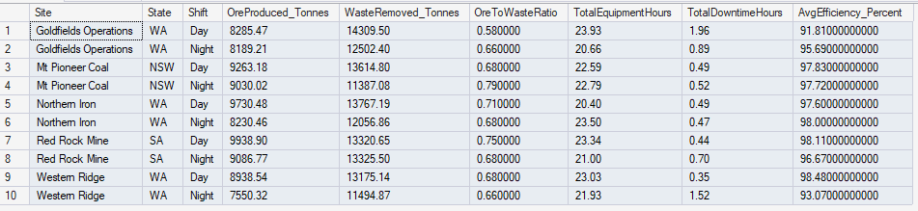
Stored Procedure/DQL: Create Procedure and Query for DailyOperationsReport: Production Summary
DECLARE @ReportDate datetime = DATEADD(DAY, -1, CAST(GETDATE() AS DATE)); --If the stored procedure Concept 6 @ReportDate does not work
SELECT
ms.site_name AS Site,
ms.state AS State,
dp.shift AS Shift,
SUM(dp.ore_tonnes) AS OreProduced_Tonnes,
SUM(dp.waste_tonnes) AS WasteRemoved_Tonnes,
ROUND(SUM(dp.ore_tonnes) / NULLIF(SUM(dp.waste_tonnes), 0), 2) AS OreToWasteRatio,
SUM(dp.equipment_hours) AS TotalEquipmentHours,
SUM(dp.downtime_hours) AS TotalDowntimeHours,
AVG(dp.efficiency_percent) AS AvgEfficiency_Percent
FROM daily_production dp
JOIN mining_sites ms ON dp.site_id = ms.site_id
WHERE dp.production_date = @ReportDate
GROUP BY ms.site_name, ms.state, dp.shift
ORDER BY ms.site_name, dp.shift;
PRINT '';

Slide 38
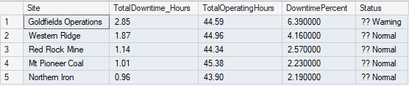
Stored Procedure/DQL: Create Procedure and Query for DailyOperationsReport: Equipment Downtime Analysis
DECLARE @ReportDate datetime = DATEADD(DAY, -1, CAST(GETDATE() AS DATE)); --If the stored procedure Concept 6 @ReportDate does not work
SELECT
ms.site_name AS Site,
SUM(dp.downtime_hours) AS TotalDowntime_Hours,
SUM(dp.equipment_hours) AS TotalOperatingHours,
ROUND((SUM(dp.downtime_hours) / NULLIF(SUM(dp.equipment_hours), 0)) * 100, 2) AS DowntimePercent,
CASE
WHEN ROUND((SUM(dp.downtime_hours) / NULLIF(SUM(dp.equipment_hours), 0)) * 100, 2) > 10 THEN '🔴 Critical'
WHEN ROUND((SUM(dp.downtime_hours) / NULLIF(SUM(dp.equipment_hours), 0)) * 100, 2) > 5 THEN '🟡 Warning'
ELSE '🟢 Normal'
END AS Status
FROM daily_production dp
JOIN mining_sites ms ON dp.site_id = ms.site_id
WHERE dp.production_date = @ReportDate
GROUP BY ms.site_name
ORDER BY DowntimePercent DESC;
PRINT '';

Slide 39

Stored Procedure/DQL: Create Procedure and Query for DailyOperationsReport: Safety Incidents
SELECT
si.incident_id AS IncidentID,
si.incident_date AS Date,
ms.site_name AS Site,
si.severity AS Severity,
si.incident_type AS Type,
si.description AS Description,
DATEDIFF(DAY, si.incident_date, GETDATE()) AS DaysOpen
FROM safety_incidents si
JOIN mining_sites ms ON si.site_id = ms.site_id
WHERE si.resolved = 0
ORDER BY
CASE si.severity
WHEN 'Severe' THEN 1
WHEN 'Moderate' THEN 2
ELSE 3
END,
si.incident_date;
PRINT '';

Slide 40
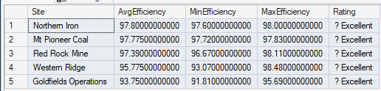
Stored Procedure/DQL: Create Procedure and Query for DailyOperationsReport: Efficiency Metrics
DECLARE @ReportDate datetime = DATEADD(DAY, -1, CAST(GETDATE() AS DATE)); --If the stored procedure Concept 6 @ReportDate does not work
SELECT
ms.site_name AS Site,
AVG(dp.efficiency_percent) AS AvgEfficiency,
MIN(dp.efficiency_percent) AS MinEfficiency,
MAX(dp.efficiency_percent) AS MaxEfficiency,
CASE
WHEN AVG(dp.efficiency_percent) >= 90 THEN '⭐ Excellent'
WHEN AVG(dp.efficiency_percent) >= 80 THEN '✅ Good'
WHEN AVG(dp.efficiency_percent) >= 70 THEN '⚠️ Fair'
ELSE '❌ Needs Improvement'
END AS Rating
FROM daily_production dp
JOIN mining_sites ms ON dp.site_id = ms.site_id
WHERE dp.production_date = @ReportDate
GROUP BY ms.site_name
ORDER BY AvgEfficiency DESC;
PRINT '';

Slide 41
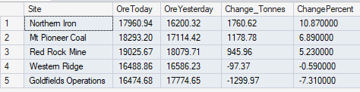
Stored Procedure/DQL: Create Procedure and Query for DailyOperationsReport: Site Comparisons
DECLARE @ReportDate datetime = DATEADD(DAY, -1, CAST(GETDATE() AS DATE));
DECLARE @PreviousDay DATE = DATEADD(DAY, -1, @ReportDate);
SELECT
ms.site_name AS Site,
SUM(CASE WHEN dp.production_date = @ReportDate THEN dp.ore_tonnes ELSE 0 END) AS OreToday,
SUM(CASE WHEN dp.production_date = @PreviousDay THEN dp.ore_tonnes ELSE 0 END) AS OreYesterday,
SUM(CASE WHEN dp.production_date = @ReportDate THEN dp.ore_tonnes ELSE 0 END) -
SUM(CASE WHEN dp.production_date = @PreviousDay THEN dp.ore_tonnes ELSE 0 END) AS Change_Tonnes,
ROUND(
((SUM(CASE WHEN dp.production_date = @ReportDate THEN dp.ore_tonnes ELSE 0 END) - SUM(CASE WHEN dp.production_date = @PreviousDay THEN dp.ore_tonnes ELSE 0 END)) /
NULLIF(SUM(CASE WHEN dp.production_date = @PreviousDay THEN dp.ore_tonnes ELSE 0 END), 0)) * 100,
2) AS ChangePercent
FROM daily_production dp
JOIN mining_sites ms ON dp.site_id = ms.site_id
WHERE dp.production_date IN (@ReportDate, @PreviousDay)
GROUP BY ms.site_name
ORDER BY ChangePercent DESC;

Slide 42
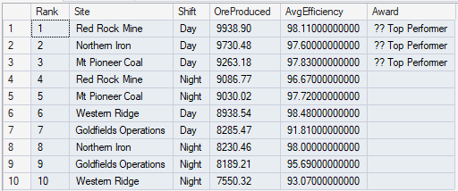
Stored Procedure/DQL: Create Procedure and Query for DailyOperationsReport: SHIFT PERFORMANCE RANKINGS
DECLARE @ReportDate datetime = DATEADD(DAY, -1, CAST(GETDATE() AS DATE));
SELECT
ROW_NUMBER() OVER (ORDER BY SUM(dp.ore_tonnes) DESC) AS Rank,
ms.site_name AS Site,
dp.shift AS Shift,
SUM(dp.ore_tonnes) AS OreProduced,
AVG(dp.efficiency_percent) AS AvgEfficiency,
CASE
WHEN ROW_NUMBER() OVER (ORDER BY SUM(dp.ore_tonnes) DESC) <= 3 THEN '🏆 Top Performer'
ELSE ''
END AS Award
FROM daily_production dp
JOIN mining_sites ms ON dp.site_id = ms.site_id
WHERE dp.production_date = @ReportDate
GROUP BY ms.site_name, dp.shift
ORDER BY OreProduced DESC;

Slide 43
Stored Procedure/DQL: Create Procedure and Query for DailyOperationsReport: Executive Summary
DECLARE @ReportDate datetime = DATEADD(DAY, -1, CAST(GETDATE() AS DATE));
-- Calculate totals
DECLARE @TotalOre DECIMAL(12,2);
DECLARE @TotalWaste DECIMAL(12,2);
DECLARE @TotalIncidents INT;
DECLARE @AvgEfficiency DECIMAL(5,2);
SELECT
@TotalOre = SUM(ore_tonnes),
@TotalWaste = SUM(waste_tonnes),
@AvgEfficiency = AVG(efficiency_percent)
FROM daily_production
WHERE production_date = @ReportDate;
SELECT @TotalIncidents = COUNT(*)
FROM safety_incidents
WHERE resolved = 0;
PRINT ' Total Ore Produced: ' + FORMAT(@TotalOre, 'N2') + ' tonnes';
PRINT ' Total Waste Removed: ' + FORMAT(@TotalWaste, 'N2') + ' tonnes';
PRINT ' Average Efficiency: ' + CAST(@AvgEfficiency AS NVARCHAR(10)) + '%';
PRINT ' Unresolved Incidents: ' + CAST(@TotalIncidents AS NVARCHAR(10));
--Total Ore Produced: 88,243.35 tonnes
-- Total Waste Removed: 128,953.99 tonnes
--Average Efficiency: 96.50%
--Unresolved Incidents: 3

Slide 44
Stored Procedure/DQL: Create Procedure and Query for DailyOperationsReport: Daily Operations Report
-- Execute the daily report
EXEC DailyOperationsReport;

Slide 45
Stored Function/DQL: Create Function and Query for dbo.CalculateEfficiency Part 1
IF OBJECT_ID('dbo.CalculateEfficiency', 'FN') IS NOT NULL
DROP FUNCTION dbo.CalculateEfficiency;
GO
CREATE FUNCTION dbo.CalculateEfficiency
(
@EquipmentHours DECIMAL(8,2),
@DowntimeHours DECIMAL(6,2)
)
RETURNS DECIMAL(5,2)
AS
BEGIN
/*
Purpose: Calculate equipment efficiency percentage
Parameters: @EquipmentHours, @DowntimeHours
Returns: Efficiency % (0-100)
Example: SELECT dbo.CalculateEfficiency(20, 2) → 90.00
*/
DECLARE @Efficiency DECIMAL(5,2);
IF @EquipmentHours > 0
SET @Efficiency = ROUND(((@EquipmentHours - @DowntimeHours) / @EquipmentHours) * 100, 2);
ELSE
SET @Efficiency = 0;
RETURN @Efficiency;
END
GO

Slide 46
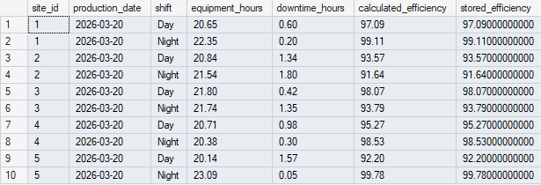
Stored Function/DQL: Create Function and Query for dbo.CalculateEfficiency Part 2
SELECT
site_id,
production_date,
shift,
equipment_hours,
downtime_hours,
dbo.CalculateEfficiency(equipment_hours, downtime_hours) AS calculated_efficiency,
efficiency_percent AS stored_efficiency
FROM daily_production
WHERE production_date = (SELECT MAX(production_date) FROM daily_production)
ORDER BY site_id, shift;

Slide 47
Stored Function/DQL: Create Function and Query for dbo.GetHighDowntimeSites Part 1
IF OBJECT_ID('dbo.GetHighDowntimeSites', 'IF') IS NOT NULL
DROP FUNCTION dbo.GetHighDowntimeSites;
GO
CREATE FUNCTION dbo.GetHighDowntimeSites
(
@ThresholdPercent DECIMAL(5,2)
)

Slide 48
Stored Function/DQL: Create Function and Query for dbo.GetHighDowntimeSites Part 2
RETURNS TABLE
AS
RETURN
(
/*
Purpose: Return sites with downtime above threshold
Parameters: @ThresholdPercent (e.g., 5.0 for 5%)
Returns: Table with site details and downtime metrics
Example: SELECT * FROM dbo.GetHighDowntimeSites(5.0);
*/

Slide 49
Stored Function/DQL: Create Function and Query for dbo.GetHighDowntimeSites Part 3
SELECT
ms.site_name,
ms.site_location,
ms.state,
SUM(dp.downtime_hours) AS total_downtime_hours,
SUM(dp.equipment_hours) AS total_equipment_hours,
ROUND((SUM(dp.downtime_hours) / NULLIF(SUM(dp.equipment_hours), 0)) * 100, 2) AS downtime_percent,
CASE
WHEN ROUND((SUM(dp.downtime_hours) / NULLIF(SUM(dp.equipment_hours), 0)) * 100, 2) > 10 THEN 'Critical'
WHEN ROUND((SUM(dp.downtime_hours) / NULLIF(SUM(dp.equipment_hours), 0)) * 100, 2) > 5 THEN 'Warning'
ELSE 'Normal'
END AS status
FROM daily_production dp
JOIN mining_sites ms ON dp.site_id = ms.site_id
WHERE dp.production_date >= DATEADD(DAY, -7, GETDATE())
GROUP BY ms.site_name, ms.site_location, ms.state
HAVING ROUND((SUM(dp.downtime_hours) / NULLIF(SUM(dp.equipment_hours), 0)) * 100, 2) > @ThresholdPercent
);
GO

Slide 50
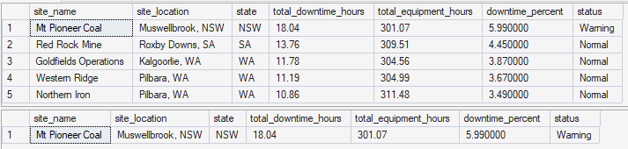
Stored Function/DQL: Create Function and Query for dbo.GetHighDowntimeSites: Results
PRINT '✅ Function created: dbo.GetHighDowntimeSites';
PRINT '';
PRINT 'Using table-valued function...';
PRINT '';
PRINT '--- Sites with downtime > 3% ---';
SELECT * FROM dbo.GetHighDowntimeSites(3.0)
ORDER BY downtime_percent DESC;
PRINT '';
PRINT '--- Sites with downtime > 5% ---';
SELECT * FROM dbo.GetHighDowntimeSites(5.0)
ORDER BY downtime_percent DESC;
PRINT '';
GO

Slide 51
Stored Procedure/DQL: Create Procedure and Query for GetIncidentsBySeverity Part 1
-- SOLUTION 1: GetIncidentsBySeverity
PRINT '--- SOLUTION 1: GetIncidentsBySeverity Procedure ---';
PRINT '';
IF OBJECT_ID('GetIncidentsBySeverity', 'P') IS NOT NULL
DROP PROCEDURE GetIncidentsBySeverity;
GO

Slide 52
Stored Procedure/DQL: Create Procedure and Query for GetIncidentsBySeverity Part 2
CREATE PROCEDURE GetIncidentsBySeverity
@Severity NVARCHAR(20)
AS
BEGIN
SELECT
si.incident_id,
si.incident_date,
ms.site_name,
ms.state,
si.severity,
si.incident_type,
si.description,
CASE WHEN si.resolved = 1 THEN 'Resolved' ELSE 'Open' END AS status,
si.resolved_date,
CASE
WHEN si.resolved = 0 THEN DATEDIFF(DAY, si.incident_date, GETDATE())
ELSE DATEDIFF(DAY, si.incident_date, si.resolved_date)
END AS days_to_resolution
FROM safety_incidents si
JOIN mining_sites ms ON si.site_id = ms.site_id
WHERE si.severity = @Severity
ORDER BY si.incident_date DESC;
END
GO

Slide 53
Stored Procedure/DQL: Create Procedure and Query for GetIncidentsBySeverity Part 3
PRINT 'Testing: EXEC GetIncidentsBySeverity @Severity = ''Moderate'';';
EXEC GetIncidentsBySeverity @Severity = 'Moderate';
PRINT '';
GO

Slide 54
Stored Procedure/DQL: Create Procedure and Query for GetProductionSummary
-- SOLUTION 2: GetProductionSummary with Defaults
PRINT '--- SOLUTION 2: GetProductionSummary with Defaults ---';
PRINT '';
IF OBJECT_ID('GetProductionSummary', 'P') IS NOT NULL
DROP PROCEDURE GetProductionSummary;
GO
CREATE PROCEDURE GetProductionSummary
@StartDate DATE = NULL,
@EndDate DATE = NULL
AS

Slide 55
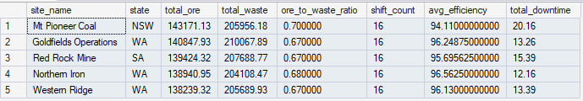
Stored Procedure/DQL: Create Procedure and Query for GetProductionSummary Part 2
BEGIN
-- Default to last 7 days if not provided
IF @StartDate IS NULL SET @StartDate = DATEADD(DAY, -7, GETDATE());
IF @EndDate IS NULL SET @EndDate = CAST(GETDATE() AS DATE);
SELECT
ms.site_name,
ms.state,
SUM(dp.ore_tonnes) AS total_ore,
SUM(dp.waste_tonnes) AS total_waste,
ROUND(SUM(dp.ore_tonnes) / NULLIF(SUM(dp.waste_tonnes), 0), 2) AS ore_to_waste_ratio,
COUNT(*) AS shift_count,
AVG(dp.efficiency_percent) AS avg_efficiency,
SUM(dp.downtime_hours) AS total_downtime
FROM daily_production dp
JOIN mining_sites ms ON dp.site_id = ms.site_id
WHERE dp.production_date BETWEEN @StartDate AND @EndDate
GROUP BY ms.site_name, ms.state
ORDER BY total_ore DESC;
END
GO
PRINT 'Testing: EXEC GetProductionSummary; (uses defaults)';
EXEC GetProductionSummary;
PRINT '';
GO

Slide 56
Stored Function/DQL: Create Function and Query for dbo.CalculateOreToWasteRatio Part 1
-- SOLUTION 3: CalculateOreToWasteRatio Scalar Function
PRINT '--- SOLUTION 3: CalculateOreToWasteRatio Function ---';
PRINT '';
IF OBJECT_ID('dbo.CalculateOreToWasteRatio', 'FN') IS NOT NULL
DROP FUNCTION dbo.CalculateOreToWasteRatio;
GO
CREATE FUNCTION dbo.CalculateOreToWasteRatio
(
@OreTonnes DECIMAL(12,2),
@WasteTonnes DECIMAL(12,2)
)
RETURNS DECIMAL(5,2)
AS
BEGIN
DECLARE @Ratio DECIMAL(5,2);
IF @WasteTonnes > 0
SET @Ratio = ROUND(@OreTonnes / @WasteTonnes, 2);
ELSE
SET @Ratio = 0;
RETURN @Ratio;
END
GO

Slide 57
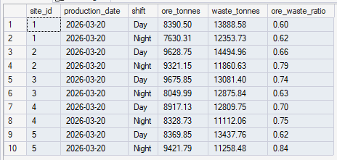
Stored Function/DQL: Create Function and Query for dbo.CalculateOreToWasteRatio Part 2
PRINT 'Testing: Using function in SELECT...';
SELECT TOP 10
site_id,
production_date,
shift,
ore_tonnes,
waste_tonnes,
dbo.CalculateOreToWasteRatio(ore_tonnes, waste_tonnes) AS ore_waste_ratio
FROM daily_production
WHERE production_date = (SELECT MAX(production_date) FROM daily_production)
ORDER BY site_id, shift;
PRINT '';
GO

Slide 58
Stored Function/DQL: Create Function and Query for dbo.GetTopPerformingSites Part 1
-- SOLUTION 4: GetTopPerformingSites Table-Valued Function
PRINT '--- SOLUTION 4: GetTopPerformingSites Function ---';
PRINT '';
IF OBJECT_ID('dbo.GetTopPerformingSites', 'IF') IS NOT NULL
DROP FUNCTION dbo.GetTopPerformingSites;
GO
CREATE FUNCTION dbo.GetTopPerformingSites
(
@TopN INT
)

Slide 59

Stored Function/DQL: Create Function and Query for dbo.GetTopPerformingSites Part 2
RETURNS TABLE
AS
RETURN
(
SELECT TOP (@TopN)
ms.site_name,
ms.state,
ms.commodity,
SUM(dp.ore_tonnes) AS total_ore_tonnes,
AVG(dp.efficiency_percent) AS avg_efficiency,
SUM(dp.downtime_hours) AS total_downtime,
COUNT(*) AS production_records
FROM daily_production dp
JOIN mining_sites ms ON dp.site_id = ms.site_id
WHERE dp.production_date >= DATEADD(DAY, -7, GETDATE())
GROUP BY ms.site_name, ms.state, ms.commodity
ORDER BY SUM(dp.ore_tonnes) DESC
);
GO
PRINT 'Testing: SELECT * FROM dbo.GetTopPerformingSites(3);';
SELECT * FROM dbo.GetTopPerformingSites(3);
PRINT '';
GO

Slide 60
Stored Procedure/DQL: Create Procedure and Query for UpdateIncidentStatus Part 1
-- SOLUTION 5: UpdateIncidentStatus with Error Handling
PRINT '--- SOLUTION 5: UpdateIncidentStatus Procedure ---';
PRINT '';
IF OBJECT_ID('UpdateIncidentStatus', 'P') IS NOT NULL
DROP PROCEDURE UpdateIncidentStatus;
GO

Slide 61
Stored Procedure/DQL: Create Procedure and Query for UpdateIncidentStatus Part 2
CREATE PROCEDURE UpdateIncidentStatus
@IncidentID INT,
@Resolved BIT
AS
BEGIN
SET NOCOUNT ON;
BEGIN TRY
-- Validation 1: Check incident exists
IF NOT EXISTS (SELECT 1 FROM safety_incidents WHERE incident_id = @IncidentID)
THROW 50001, 'Incident ID not found in database', 1;
-- Validation 2: Check if already in requested state
IF EXISTS (SELECT 1 FROM safety_incidents WHERE incident_id = @IncidentID AND resolved = @Resolved)
BEGIN
DECLARE @StatusMsg NVARCHAR(100) = CASE WHEN @Resolved = 1 THEN 'already resolved' ELSE 'already open' END;
DECLARE @ErrMsg NVARCHAR(200) = 'Incident ' + CAST(@IncidentID AS NVARCHAR(10)) + ' is ' + @StatusMsg;
THROW 50002, @ErrMsg, 1;
END

Slide 62
Stored Procedure/DQL: Create Procedure and Query for UpdateIncidentStatus Part 3
-- Update the incident
UPDATE safety_incidents
SET
resolved = @Resolved,
resolved_date = CASE WHEN @Resolved = 1 THEN CAST(GETDATE() AS DATE) ELSE NULL END
WHERE incident_id = @IncidentID;
-- Success message
DECLARE @SuccessMsg NVARCHAR(200);
SET @SuccessMsg = '✅ Incident ' + CAST(@IncidentID AS NVARCHAR(10)) +
CASE WHEN @Resolved = 1 THEN ' marked as RESOLVED' ELSE ' reopened' END;
PRINT @SuccessMsg;
-- Show updated incident
SELECT
incident_id,
incident_date,
severity,
incident_type,
CASE WHEN resolved = 1 THEN 'Resolved' ELSE 'Open' END AS status,
resolved_date
FROM safety_incidents
WHERE incident_id = @IncidentID;
END TRY

Slide 63
Stored Procedure/DQL: Create Procedure and Query for UpdateIncidentStatus Part 4
BEGIN CATCH
-- Log and display error
DECLARE @ErrorMessage NVARCHAR(4000) = ERROR_MESSAGE();
DECLARE @ErrorSeverity INT = ERROR_SEVERITY();
INSERT INTO error_log (error_message, error_procedure, error_line, error_severity, error_state)
VALUES (@ErrorMessage, 'UpdateIncidentStatus', ERROR_LINE(), @ErrorSeverity, ERROR_STATE());
PRINT '❌ Error: ' + @ErrorMessage;
THROW;
END CATCH
END
GO

Slide 64
Stored Procedure/DQL: Create Procedure and Query for UpdateIncidentStatus Part 5
PRINT 'Testing: Updating incident status...';
PRINT ‘’;
PRINT '--- Test 1: Mark incident as resolved ---';
EXEC UpdateIncidentStatus @IncidentID = 5, @Resolved = 1;
PRINT '';
PRINT '--- Test 2: Try to resolve same incident again (should error) ---';
BEGIN TRY
EXEC UpdateIncidentStatus @IncidentID = 5, @Resolved = 1;
END TRY
BEGIN CATCH
PRINT 'Caught expected error: ' + ERROR_MESSAGE();
END CATCH
PRINT '';
PRINT '--- Test 3: Invalid incident ID (should error) ---';
BEGIN TRY
EXEC UpdateIncidentStatus @IncidentID = 9999, @Resolved = 1;
END TRY
BEGIN CATCH
PRINT 'Caught expected error: ' + ERROR_MESSAGE();
END CATCH
PRINT '';
GO

Slide 65

FINAL DATA SUMMARY
SELECT
'Database Objects Created' AS Summary,
(SELECT COUNT(*) FROM sys.procedures WHERE name LIKE 'Get%' OR name LIKE 'Update%' OR name = 'DailyOperationsReport') AS Procedures,
(SELECT COUNT(*) FROM sys.objects WHERE type IN ('FN', 'IF', 'TF')) AS Functions,
(SELECT COUNT(*) FROM sys.tables WHERE name <> 'sysdiagrams') AS Tables;
PRINT 'All objects created successfully! Database ready for use.';
PRINT '';
GO

